Slide 1
Project DIRECT JOINT IRISH / UK SEMINAR Wellington Park Hotel, Malone Road, Belfast, BT9 6RU 5 and 6 March 2018
Michael Gold and Chris Rees

Slide 2
What this presentation covers…
Presentation based on interim results from project
Overview of social partner views on direct participation
Toyota: outline of direct participation (the ‘Toyota Way’)
Leeds Teaching Hospitals NHS Trust (the ‘Leeds Way’)
Contrasts and comparisons:
to what extent can the ‘Toyota Way’ be transferred to hospitals and embedded into them?

Slide 3
General summary of social partner views
DP is restricted to operational, not strategic, issues
DP generally introduced at management initiative, hence seen as a management tool (e.g. communications, employee surveys, team briefings)
Skills and resources required to make DP work, so it’s not just a form of PR
TUs accept DP as part of management function, but seek to adapt it to their own agenda, e.g. to enhance skills (through union learning reps and learning agreements)
DP seen by TUs to work best alongside TU representation and collective bargaining
DP may also be delegative, and so potentially transformative - hence ‘surface’ forms of DP co-exist alongside ‘deeper’ forms
This presentation focuses on these ‘deeper’ forms and their durability, and how they interact with union interests.

Slide 4
Toyota
Toyota Motor Manufacturing (UK) opened 1992:
Burnaston (Derby): car manufacturing/ assembly (2,500 workers – or ‘members’)
Deeside: engine manufacturing (500 members)
Hence 3,000 members in total: 90% production, 10% office/ support
The two sites operate as one plant
‘Single status’ employment, one union (Unite)

Slide 5
Employee representation
Toyota Members’ Advisory Board (TMAB), covers both sites
Agenda: all company issues, information, consultation, negotiation of annual pay round, H&S, dispute resolution
12 members plus full-time convenor
Unite – single union (55% density overall)
Since 2014, all members of TMAB must be Unite, and only Unite members may be represented by Unite

Slide 6
The ‘Toyota Way’: Communications
Directors – staged events
Communications time built into each shift
Cascade briefings through teams/ sections/ groups: ten-ten briefs (10 minutes at 10.00)
Notice boards, videos in plant entrances
‘Communication is king’
‘We spend all our time in meetings’
(Unite FT Convenor)

Slide 7
The ‘Toyota Way’: Continuous improvement
Kaizen – ‘continuous improvement’
Covers quality, costs, environment, H&S etc.
Operates at all levels: teams/ sections/ groups
Expectation of two kaizen per member per month – feeds into appraisal system
H&S kaizen – two Mondays a month, teams evaluate a work process
Quality circles – a tool to promote problem-solving skills
One or two a year in each shop
Area selected for problem-solving
Greater detail than kaizen, and teams are involved

Slide 8
Hence multi-skilling…
Lean production – versatility essential
Single grading system – no occupational categories other than member, team leader, group leader and section leader
Each member proficient in at least two processes (assembly, paint, welding etc.)
Processes themselves largely designed/ shaped by members
‘We don’t know anything different’; ‘Kaizen becomes second nature’ (Unite FT Convenor)

Slide 9
Work intensification?
Toyota Way: long-term stable employment
‘Kaizen won’t work if it threatens jobs’ (HR Manager)
Intention is to remove job content to reduce burden on workers
Line speed is determined by customer demand – what changes is the number of processes required to build a car (e.g. reduction from 100 to 75 over the course of a production cycle)
But: source of conflict is contracted overtime
Maximum two hours’ overtime may be expected on the day, 90 minutes’ notice
‘You never quite know when you’re going home’ (Unite FT Convenor)

Slide 10
Reasons for success
Greenfield site (‘We don’t know anything different’)
Recruitment process:
- Number of applications
- Blue Arrow (agency) used for numerical flexibility and as an employment filter (10% members)
Internal labour market
- But: turnover of members: 2%, turnover of agency staff: 20%
Management continuity
Competitive pay and conditions
Guaranteed no redundancies/ work intensification

Slide 11
Does the ‘Toyota Way’ transfer to the health service?
Mid Staffs Hospital crisis (2005-09)
Francis Inquiry Report (February 2013)
“A disputed estimate suggested that between 400 and 1,200 patients died as a result of poor care over the 50 months between January 2005 and March 2009 at Stafford hospital, a small district general hospital in Staffordshire.
It is commonly known as the Mid Staffs scandal because Stafford hospital was and is run by the Mid Staffordshire NHS hospital trust, which in 2008 acquired foundation trust status, making it semi-independent of Department of Health control. Decision-making and especially cost-cutting as part of its pursuit of that status was later cited as a key reason why poor care took hold and was allowed to persist for so long.”
(Guardian, 6 February 2013)

Slide 12
Ways forward…
NHS made £12.5 m available to five NHS Trusts to buy into the training methods advocated by the Virginia Mason Institute (healthcare institute)
Leeds Teaching Hospitals NHS Trust was one of the five successful bidders
Basic principle: place the patient first

Slide 13
The ‘Leeds Way’
The Leeds Improvement Method championed by Trust Chair, Linda Pollard (appointed Feb 2013), and CEO, Julian Hartley (appointed Oct 2013)
Crowdsourcing of all 17,000 employees to establish ‘our values’ (5,000 contributed):
Patient-centred
Fair
Accountable
Collaborative
Empowered
Toyota-style management integrated into all Leeds NHS Trust procedures, including kaizen, ‘from porters to professors’

Slide 14
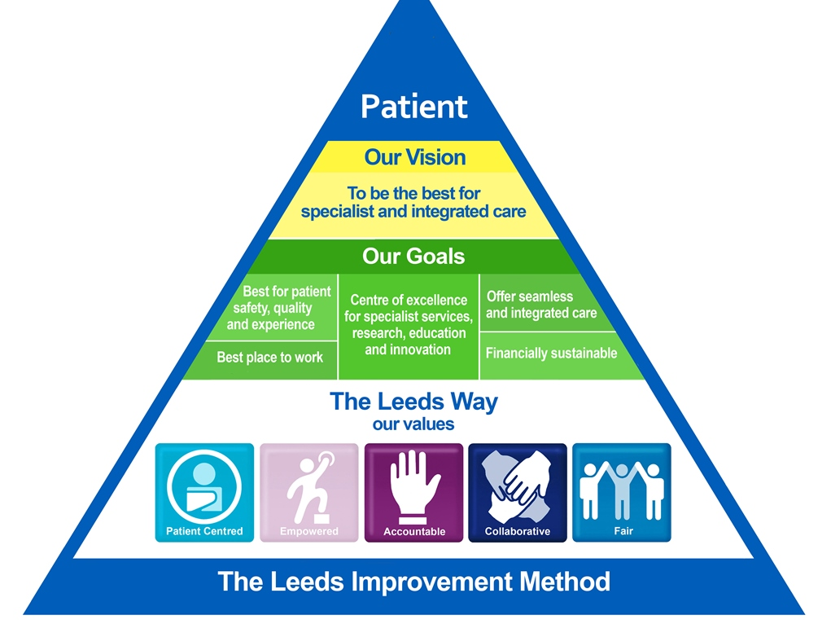

Slide 15
The Leeds Improvement Method
Weekly induction carried out personally by CEO (50-100 new staff every week)
‘Town hall type meetings’
Kaizen
Rapid improvement weeks: intense discussions on how to reduce waste (e.g. patient records, reception areas)
‘Safety huddles’
Staff recognised for good ideas, but no expectations about numbers of kaizen to be proposed

Slide 16
Staff-side reactions
Respect for staff embedded in system to prevent work intensification (which would be challenged by the unions)
No redundancies result from improvements
Focus on waste reduction and improvements, not cost-cutting
Chair of Staff Council involved from start to keep everything open (Staff Council represents 14 staff-side organisations, including Unite, Unison and GMB, as well as RCN, RCM etc.)

Slide 17
Results….
Staff surveys over 12 years – linear data, same questions
Between 5,000 and 7,000 returns out of 17,000 staff
2012: 18 questions in bottom 20%, one in top 20%
2017: one question in bottom 20%, 13 in top 20%
N.B. -
Only 2.4% payroll spent on agency staff
Very little outsourcing – patient catering, cleaning, security, estates/ facilities all in-house.

Slide 18
Toyota/ Leeds NHS Trust comparisons (1)
How embedded is the ‘Leeds Way’?
Brownfield v. greenfield sites
Continuity of management at Toyota (personnel and style)
Recruitment – members at Toyota a ‘blank slate’, single status, very few occupational categories, integrated production
Stable employment – agency used as a buffer to protect ‘core’

Slide 19
Toyota/ Leeds NHS Trust comparisons (2)
Political nature of NHS, Mid Staffs crisis led to re-think (Cf. MRSA deaths led to rethink over outsourcing hospital cleaning services)
Leeds NHS Trust bought into the Virginia Mason method following competitive bidding process
‘Leeds Way’ led by ‘champions’ from the top: future change of management or priorities could change things back? what if Julian Hartley were to leave?
Recruitment – Leeds, many levels, many occupations, higher turnover, some categories recruited by the university (e.g. student nurses)

Slide 20
Conclusions
Durability of direct participation at its most transformative – many factors involved, e.g.
Greenfield/ brownfield site?
Continuity of management?
Dependence on champions?
Control over recruitment?
Nature of local labour markets?
Nature of the work itself? (Hospitals are far more complex than car plants!)
And, of course, role of unions?

Slide 21
Summary of interviews
Stage two: eight interviewees, five social partner organisations
IPA – Patrick Briône, Derek Luckhurst (12 September 2017)
CIPD – Ramya Yarlagadda (14 September 2017)
Unite the Union – Tony Burke, Ben Richards (22 September 2017)
TUC – Matthew Creagh, Iain Murray (18 December 2017)
Workplace Innovation Ltd/ Workplace Innovation Europe – Peter Totterdill (10 January 2018)
(CBI – declined, 17 August 2017)

Slide 22
Summary of interviews
Stage three: eight interviewees, two organisations (manufacturing/ hospital)
Toyota Motor Manufacturing UK:
Peter Tsouvallaris, full-time senior representative, Unite (21 Feb 2018)
Tom Sawyer, Unite, East Midlands Regional Officer (21 Feb 2018)
Dan Janes, section manager, Human Resources (21 Feb 2018)
Leeds Teaching Hospitals NHS Trust (St James’s University Hospital, Leeds):
Dean Royles, Director of HR and Organisational Development (27 Feb 2018)
Joe Cohen, Chair of Staff Council (27 Feb 2018)
Karen Vella, Deputy Director of HR – Organisational Development (27 Feb 2018)
Wyn Jones, Deputy Director of HR – Resourcing and Workforce Systems (28 Feb 2018)
Julie Sutcliffe, Head of Medical Workforce (28 Feb 2018)

Slide 23
Partner Trusts (Virginia Mason methods)
University Hospitals Coventry and Warwickshire NHS Trust
Shrewsbury and Telford Hospital NHS Trust
Barking, Havering and Redbridge University Hospitals NHS Trust
Leeds Teaching Hospitals NHS Trust
Surrey and Sussex Healthcare NHS Trust

Slide 24
Leeds Teaching Hospitals NHS Trust staff profiles:
11,604 Full Time employees (65.42%)
5,815 Part Time employees (32.78%)
Of which
2,985 Fixed Term Contracts (16.82%) ** Full Time Fixed Term Contracts will also have been counted as a Full Time Employee
803 Zero Hours contacts including Bank (4.52%) ** This includes any honorary contracts where the fte is 0 and potentially substantive staff who also have a separate bank contract but not staff bank contracts.
We currently have 1,655 people on our nurse bank - both registered and unregistered staff,
343 Honorary contracts (1.93%) ** FTE can be > 0
452 Volunteers - volunteers are not classed as trust employees

