Slide 1
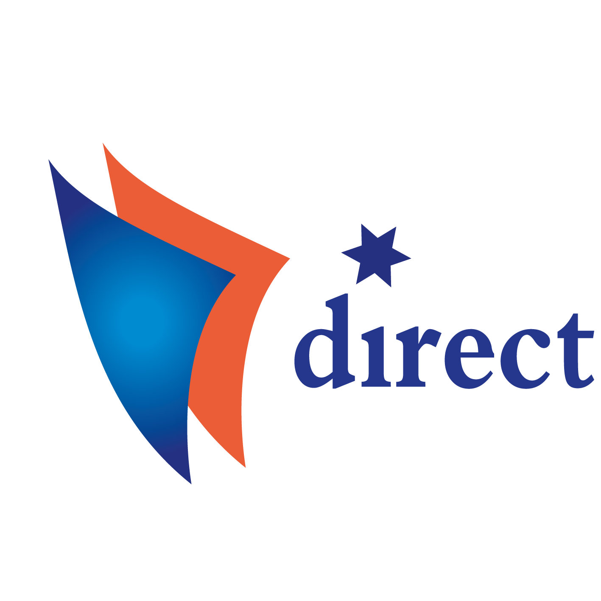
Project DIRECT General views, conclusions and recommendations from the Bulgarian research
The Development of Direct Employee Participation and its Impact on Industrial Relations at Company Level (DIRECT)
(VS/2016/0305)
Steering committee meeting
5-6 July 2018, Warsaw

Slide 2
General views and conclusions
There is already a progress in the implementation of the direct participation in the companies in Bulgaria -the coverage of companies and sectors is increasing;
Both employers’ and trade union representatives evaluate the direct participation as important and they rather remark on its’ positive impact;

Slide 3
GENERAL VIEWS
1

Slide 4
GENERAL VIEWS
Most of the respondents of the survey remarked that the main conditions for implementation of the direct participation are as follows:
good working climate;
organisational culture;
trust between the employers/managers and trade unions/other workers’ representatives;
good social dialogue

Slide 5
GENERAL VIEWS
Some employers’ representatives underlined that the direct participation could be the main mechanism to support the following management approaches*:
employee-centered management;
recruiting talents;
motivation for work ;
maintenance of qualified personnel;
employee experience management;
re-inventing management
--------------------------------
*Based on presentations of the expert from BIA at the national seminar

Slide 6
GENERAL VIEWS
According to the data of the employers associations*, in Bulgaria only 20% from the employers share the “soft” approach in human resources management, which includes the above mentioned approaches;
However, the increase of the implementation of direct participation in the companies from various sectors could be evaluated as an evidence that the managers’ views and approaches are changing.
-----------------------
*Based on presentations of the expert from BIA at the national seminar

Slide 7
CONCLUSIONS
2

Slide 8
CONCLUSIONS
Data from the interviews at sectoral level and case-studies indicated that the written provisions for direct participation (in the company rules or in collective agreements) are still rarely observed;
The forms of direct participation are rather consultative;
The main issues which are discussed are either related to the production process (or process of services providing), or issues of work, which are closely linked to the production (service providing):
Work organisation;
Working time;
Health and safety at work;
Qualification and vocational training.

Slide 9
CONCLUSIONS
Some of the data from case-studies showed that direct participation is better used in the companies, where particular work organisation (like lean production) is implemented;
The impact of the direct participation on the company management and quality of working life in general is evaluated as rather positive;
According to the case-studies data there is a link between the quality of industrial relations and the scope and results from direct participation;

Slide 10
CONCLUSIONS
There is not good integration, yet, between the forms of direct participation and the other forms of workers’ representation and participation at the company level (I&C, EWC-members, general assemblies, H&S committees, trade union mechanisms like collective bargaining etc.);
There is no evidence that the direct participation leads to neglecting of trade union influence;
However, trade unions are not well involved yet in the policies and monitoring of the direct participation;

Slide 11
CONCLUSIONS
Most of the trade union representatives at sector and company level* accept the direct participation both as managers’ approach and as an additional mechanism for information and consultation;
However, there are some fears, expressed by trade union representatives, that the use of “lean production” or “Toyota system”, together with forms of direct participation could bring to very high levels of work intensity, longer working hours, increasing stress at work.
--------------------------------------
* Based on the opinions of trade union representatives, presented at the national seminar

Slide 12
RECOMMENDATIONS
3

Slide 13
RECOMMENDATIONS
The employers/managers and trade union should be more active concerning the issues of direct participation: for example some provisions could be put into the collective agreements or in company rules (negotiated with trade unions);
The employers and managers should give more and clear information about the direct participation to the workers and increase the dissemination of the results;
The managers and trade unions in companies should make more efforts to:
- Support forms of direct participation, which could improve motivation for work, without increasing the stress and the number of working hours;
- Improve the links between the forms of direct participation and other forms of workers’ representation, as well with the governing bodies of the companies;
Trade unions could better use the information and results from direct participation in the process of preparation of collective bargaining suggestions and procedures and prevention of collective labour disputes;

Slide 14
RECOMMENDATIONS
Social partners at national and sector level could organise forums for exchange of information experience and dissemination of results and good practices of direct participation;
The experience of trade unions and employers’ organisations from other European countries and information from the European and international trade unions and employers’ organisations could be better used;
The state administration and the academic community also could be involved in further discussions;
The practices of direct participation requires further theoretical rationale and empirical and analytical research;
The main focus of research and discussions concerning direct participation could be linked with the possible changes from the process of digitalisation and the future forms and subject of direct participation.

Slide 15
Thank you for your attention!

