Slide 1
Project DIRECT Continuous Improvement in UK Health Services: the Case of Leeds Teaching Hospitals NHS Trust Sofia, 14 November 2018
Michael Gold and Chris Rees

Slide 2
What this presentation covers…
Presentation based on UK case study documentation and interviews
State of direct participation in the UK
Outline of direct participation at Toyota and at Leeds Teaching Hospitals NHS Trust
Discussion: to what extent can the ‘Toyota Way’ be transferred to hospitals and embedded into them?
Conclusions

Slide 3
Joint consultation committees (JCCs) (Van Wanrooy et al. 2011: 15)
 |  | No JCC (%) | Workplace JCC (%) | Higher level JCC only (%)
Private manufacturing | 2004 | 87 | 10 | 3
 | 2011 | 90 | 6 | 4
Private services | 2004 | 67 | 5 | 28
 | 2011 | 80 | 6 | 15
Public sector | 2004 | 28 | 19 | 53
 | 2011 | 37 | 15 | 48
All | 2004 | 64 | 7 | 28
 | 2011 | 76 | 7 | 18

Slide 4
Direct participation (Van Wanrooy et al. 2011: 18)
Method | 2004 (%) | 2011 (%)
All staff workplace meetings | 75 | 80
Team briefings | 60 | 66
Information on workplace finances | 55 | 61
Staff surveys | 36 | 37
Problem solving groups | 17 | 14

Slide 5
Toyota
Toyota Motor Manufacturing (UK) opened 1992:
Burnaston (Derby): car manufacturing/ assembly (2,500 workers – or ‘members’)
Deeside: engine manufacturing (500 members)
Hence 3,000 members in total: 90% production, 10% office/ support
The two sites operate as one plant
‘Single status’ employment, one union (Unite)

Slide 6
The ‘Toyota Way’: Communications
Directors – staged events
Communications time built into each shift
Cascade briefings through teams/ sections/ groups: ten-ten briefs (10 minutes at 10.00)
Notice boards, videos in plant entrances
‘Communication is king’

Slide 7
The ‘Toyota Way’: Continuous improvement
Kaizen – ‘continuous improvement’
Covers quality, costs, environment, H&S etc.
Operates at all levels: teams/ sections/ groups
Expectation of two kaizen per member per month – feeds into appraisal system
H&S kaizen – two Mondays a month, teams evaluate a work process
Quality circles – a tool to promote problem-solving skills
One or two a year in each shop
Area selected for problem-solving
Greater detail than kaizen, and teams are involved

Slide 8
Does the ‘Toyota Way’ transfer to the health service?
Mid Staffs Hospital crisis (2005-09)
Francis Inquiry Report (February 2013)
“A disputed estimate suggested that between 400 and 1,200 patients died as a result of poor care over the 50 months between January 2005 and March 2009 at Stafford hospital, a small district general hospital in Staffordshire.
“It is commonly known as the Mid Staffs scandal because Stafford hospital was and is run by the Mid Staffordshire NHS hospital trust, which in 2008 acquired foundation trust status, making it semi-independent of Department of Health control. Decision-making and especially cost-cutting as part of its pursuit of that status was later cited as a key reason why poor care took hold and was allowed to persist for so long.” (Guardian, 6 February 2013)

Slide 9
Origins of the ‘Leeds Way’
NHS made £12.5 m available to five NHS Trusts to buy into the training methods advocated by the Virginia Mason Institute (healthcare institute)
Leeds Teaching Hospitals NHS Trust was one of the five successful bidders
Basic principle: place the patient first

Slide 10
The ‘Leeds Way’
The Leeds Improvement Method championed by Trust Chair (appointed Feb 2013) and CEO (appointed Oct 2013)
Crowdsourcing of all 17,000 employees to establish ‘our values’ (5,000 contributed):
Patient-centred
Fair
Accountable
Collaborative
Empowered
Toyota-style management integrated into all Leeds NHS Trust procedures, including kaizen, ‘from porters to professors’

Slide 11
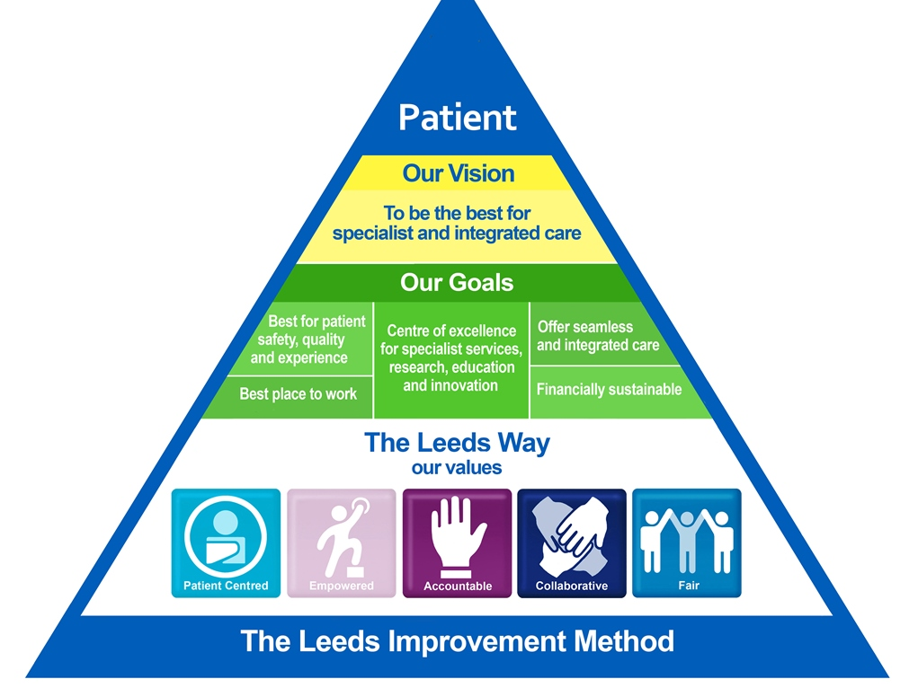

Slide 12
The Leeds Improvement Method
Weekly induction carried out personally by CEO (50-100 new staff every week)
‘Town hall type meetings’
‘Safety huddles’
Kaizen
Rapid improvement weeks: intense discussions on how to reduce waste (e.g. patient records, reception areas)
Staff recognised for good ideas, but no expectations about numbers of kaizen to be proposed

Slide 13
Similarities (Toyota/ Leeds NHS Trust)
Continuous improvement: value system as basis of culture change (‘customer/ patient comes first’)
Supportive culture: respect, no blame, ‘can-do’
Waste reduction, not cost reduction
No redundancies
Work efficiencies benefit the worker

Slide 14
Contrasts: at Leeds -
Culture change: very much ongoing
Kaizen: something new
No redundancies: unusual feature of IR in the UK
Control over recruitment: restricted
Nature of the work: hospitals more complex than car plants
Brownfield site: durability
Political nature of NHS: continuity of management
Role of the staff council: 14 staff-side organisations
Contrast with the past: at Toyota there is no such contrast!

Slide 15
Culture change at Leeds NHS Trust
…when I joined the organisation [it was] very much a hierarchical organisation, and if you were in one of the lower bands, you know, you just put up and shut up and you just got on with your job. Whereas now, I think, you know, we really do encourage people to come forward, to share their ideas, and also not to be afraid of things not working. You know, it’s all a big experiment really, isn’t it? You know, you don’t know unless you try.
Head of the Medical Workforce

Slide 16
Culture change (2)
I think we have moved away from people not taking personal responsibility because they feared the consequences if they got it wrong. So, now … there’s a narrative in the organisation about doing the right thing, and we did that because it felt like the right thing to do.
Deputy Director of HR (Organisational Development)

Slide 17
Kaizen at Leeds
…the important message is that, yes, we will keep finding something and we will solve it, and then we’ll find something else and then we’ll solve that, and we’ll keep going… We’re not going to just get to a point and go, well, that’s fine…
Deputy Director of HR (Resourcing and Workforce Systems)

Slide 18
No redundancies
What we’ve said […] is that no one here is going to lose their job through suggesting an improvement. You know, no one is going to improve themselves out of work. We haven’t, you know, other than a few sort of exceptions, 18,000 people, we haven’t done redundancies. You know, we’re growing the workforce.
Director of HR and Organisational Development

Slide 19
How durable is the Leeds way?
You could find people in this Trust who would say ‘I’ve no clue what you are talking about’. If you said ‘kaizen’, they’d look at you odd, if you said ‘Leeds Improvement’, they would have never heard of it. You see, Julian [CEO] is talking to new people coming in. People who’ve worked here 10 years, they may look blank if you said ‘Leeds Improvement Method’. So, there’s a whole comms [communications] piece that needs to be done here.
Chair of the Staff Council

Slide 20
Role of the Staff Council
If ever that methodology [the Leeds Way] brought in a different rule, at a strategic level, made an individual employee or group of employees at risk of something, or even breached their contract, then we get involved. And I think that the balance you need to keep in that partnership is when you’ve actually got a legitimate thing to challenge.
Chair of the Staff Council

Slide 21
Conclusions
Durability of direct participation at its most transformative – many factors involved, e.g.
Greenfield/ brownfield site?
Continuity of management?
Dependence on champions?
Control over recruitment?
Nature of local labour markets?
Nature of the work itself? (Hospitals are far more complex than car plants!)
And, of course, role of unions?

