Slide 1
JOINT GB/IE SEMINAR 5 and 6 March 2018
KEVIN P O’KELLY
Project Expert
The project is implemented with
the financial support of the European Commission –
DG Employment, Social Affairs and Inclusion
Budget Heading 04.03 01 06

Slide 2
JOINT GB/IE SEMINAR
Twenty-three participants:
Fourteen from IE
Eight from GB
Opening remarks from:
Sylvester Cronin IDEAS Institute (Chair)
Owen Reidy, Assistant General Secretary ICTU
Michael Gold, RHUL
Seven presentations/Case Studies
Debate

Slide 3
AGENDA
DIRECT Project – partners and results to date (Kevin)
SIPTU and Direct Participation (Gerry McCormack)
Experiences with Direct Participation in the UK (Michael and Chris)
Workplace Innovation in Ireland (Tony)
Kirchhoff Automotive – case study (John Roulstone)
Direct participation in UK enterprises – the role of the IPA (Patrick Briȏne)
Workplace Innovation (Peter Totterdill)

Slide 4
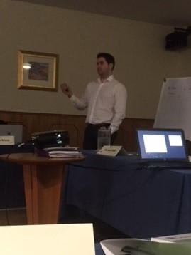
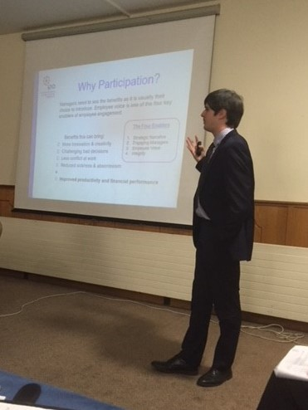
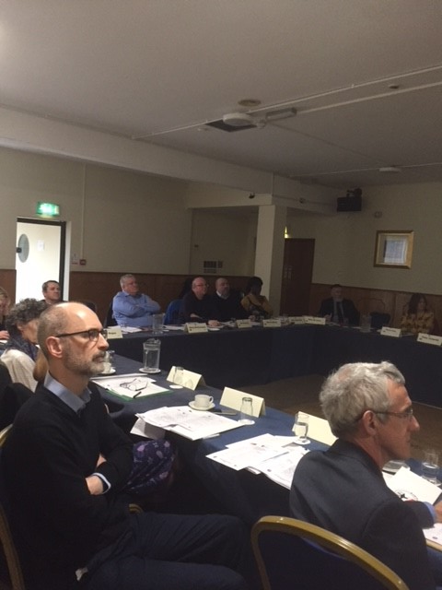

Slide 5
