Slide 1
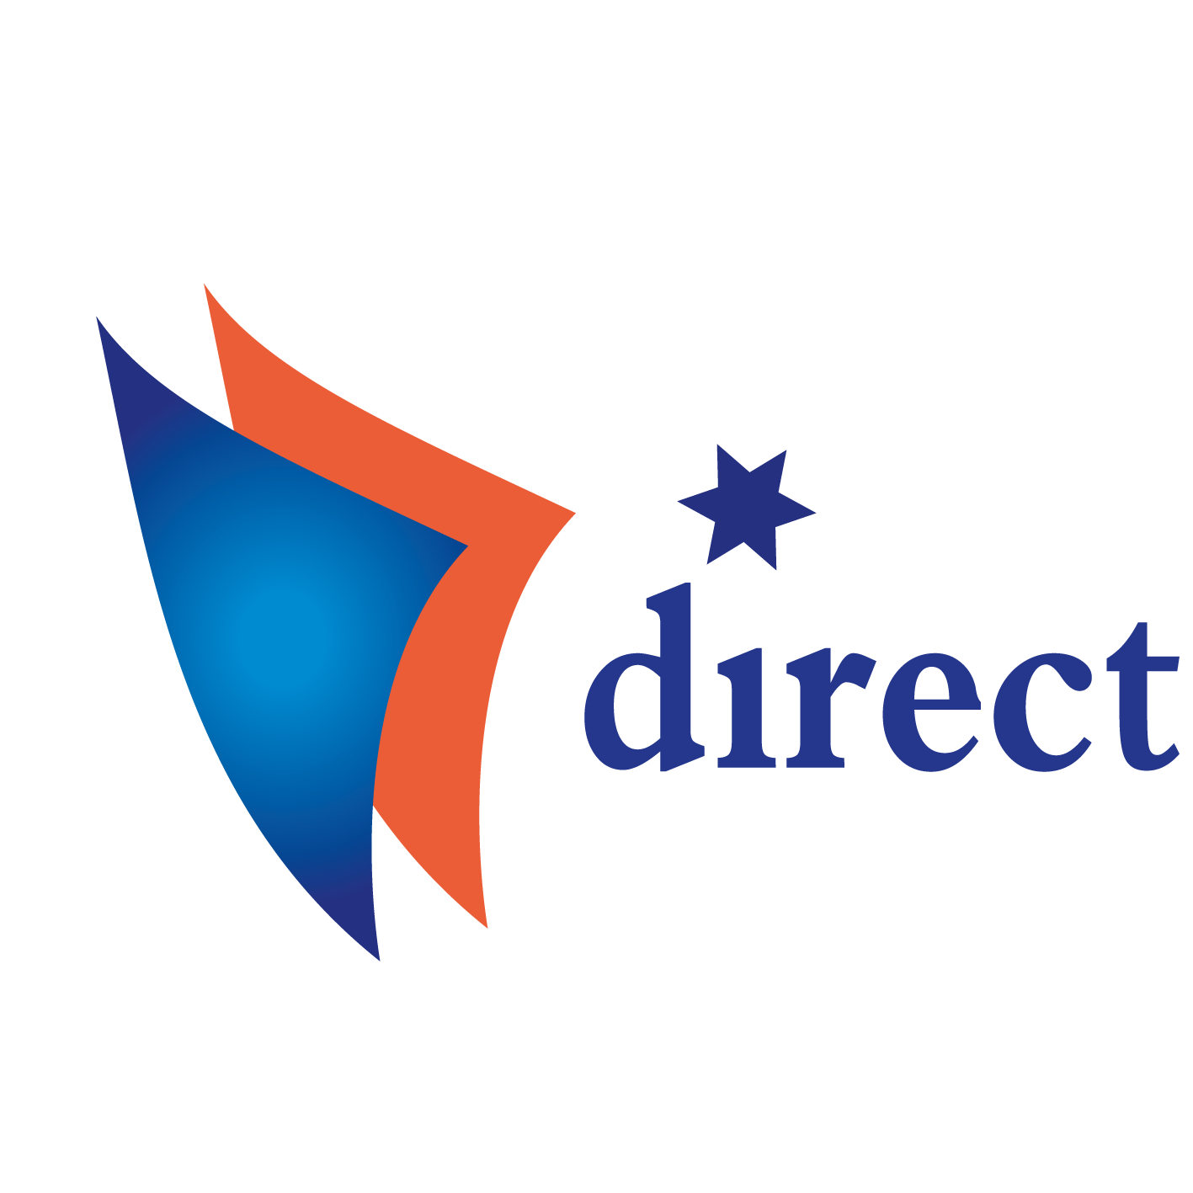
Project Direct Case-study Sofia Airport
The Development of Direct Employee Participation and its Impact on Industrial Relations at Company Level (DIRECT)
(VS/2016/0305)
Steering committee meeting
17-18 April 2018, Dublin

Slide 2
CONTENT
Main characteristics of the company
Labour, industrial relations and employee involvement
Direct participation - general features, main forms and subject
Impact of direct participation on the management of the company and quality of working life
Preliminary conclusions

Slide 3
MAIN CHARACTERISTICS OF THE COMPANY
Established in 1937, in 1990 transformed as an independent business company;
In 2000-2013 - extension and restructuring;
In 2016 an increase of the profit is reported;
For 2017 there is a growth of the number of passengers with 30%;
The airport obtained ISO 14001:2004 and ISO 9001:2008;
The company has a CSR.

Slide 4
LABOUR, INDUSTRIAL RELATIONS AND EMPLOYEE INVOLVEMENT
In 2017, around 2100 employees, 95% of them are working on full time permanent contracts and 5% on part-time permanent contracts;
There are programs for qualification and motivation;
55% of the employees are trade union members; 65% of trade union members belong to the trade union organisation of the Union of Transport Trade Unions, affiliated to CITUB, the others are members of trade union, affiliated to CL “Podkrepa”
There is a collective agreement at company level and a sectoral collective agreement is also implemented;
The I&C system is used, but via trade unions.

Slide 5
DIRECT PARTICIPATION - GENERAL FEATURES, MAIN FORMS AND SUBJECT

Slide 6
DIRECT PARTICIPATION - GENERAL FEATURES, MAIN FORMS AND SUBJECT
Individual consultations:
Main forms: regular meetings between workers and supervisors, training sessions, meetings for reporting on progress and performance of tasks;
Main topics: organization of work; working time; health and safety at work; training and staff development; quality of the services provided; relations with customers; introduction of new technologies, etc.;
According to the trade union representative, the scope of consultations is not broad enough;

Slide 7
DIRECT PARTICIPATION - GENERAL FEATURES, MAIN FORMS AND SUBJECT
Individual consultations:
Main forms: regular meetings between workers and supervisors, training sessions, meetings for reporting on progress and performance of tasks;
Main topics: organization of work; working time; health and safety at work; training and staff development; quality of the services provided; relations with customers; introduction of new technologies, etc.;
According to the trade union representative, the scope of consultations is not broad enough;

Slide 8
DIRECT PARTICIPATION - GENERAL FEATURES, MAIN FORMS AND SUBJECT
Individual delegation of responsibilities:
Main topics: preparation of the work tasks schedule; quality of the services; improvement of the work process; working conditions; elaborating the work tasks; schedule; observance of deadlines; attendance at work, etc.;
There is again a difference between the information, provided by the manager and trade union representative - the manager states that the scope is more broad.

Slide 9
DIRECT PARTICIPATION - GENERAL FEATURES, MAIN FORMS AND SUBJECT
Working teams:
The decisions to form the composition of the working group are taken jointly by the direct manager and the workers;
The issues on which the working group will have powers (consultative or delegated responsibilities) are decided by the manager;
According to the HR Manager the supervisor is the one who decides whether the decisions taken by the group are applicable at work, whereas according to the trade union shopsteward this is decided after negotiation with the workers;
According to the HR Manager the group leader is chosen jointly by the workers and the supervisor, and according to the shopsteward the supervisor is the one who usually appoints the leader of the group.

Slide 10
DIRECT PARTICIPATION - GENERAL FEATURES, MAIN FORMS AND SUBJECT
Working teams:
Group consultations:
Main topics (HR Manager): organisation of work; working time; health and safety at work; training and staff development; quality of the services provided; relations with customers; introduction of new technologies, etc.;
Trade union representative: the scope is more narrow: working time and health and safety at work;
The consultations are made at least once per month;
Delegation of responsibilities - topics:
distribution of tasks, drawing up of the work schedule and the quality of work

Slide 11
IMPACT OF DIRECT PARTICIPATION ON THE MANAGEMENT OF THE COMPANY AND QUALITY OF WORKING LIFE
Trade unions in the company are informed and participated in the negotiations concerning the direct participation;
Main results on the work efficiency:
Recognition of skills acquired by workers without an official certificate;
Improvement of qualifications, requiring official certification;
Using bonuses in work, based on individual and group achievements, quality, etc .;
Elaboration of plans for financial participation

Slide 12
Preliminary conclusions
The company has started a process of direct (mainly consultative and to some extend delegated) employee involvement;
Although the impact of direct participation on the quality of working life seems to be substantial, there are not enough evidences whether the direct participation caused pay increase; there are only indirect evidences;
Although the model is negotiated with trade unions, they should monitor it on a more regular basis and investigate independently the employees’ views on the process of direct participation and its impact on different aspects of work.

Slide 13
Thank you for your attention !

